Slide 1
An introduction to Temporal & Durable Execution
Sept 19th, 2023

Slide 2
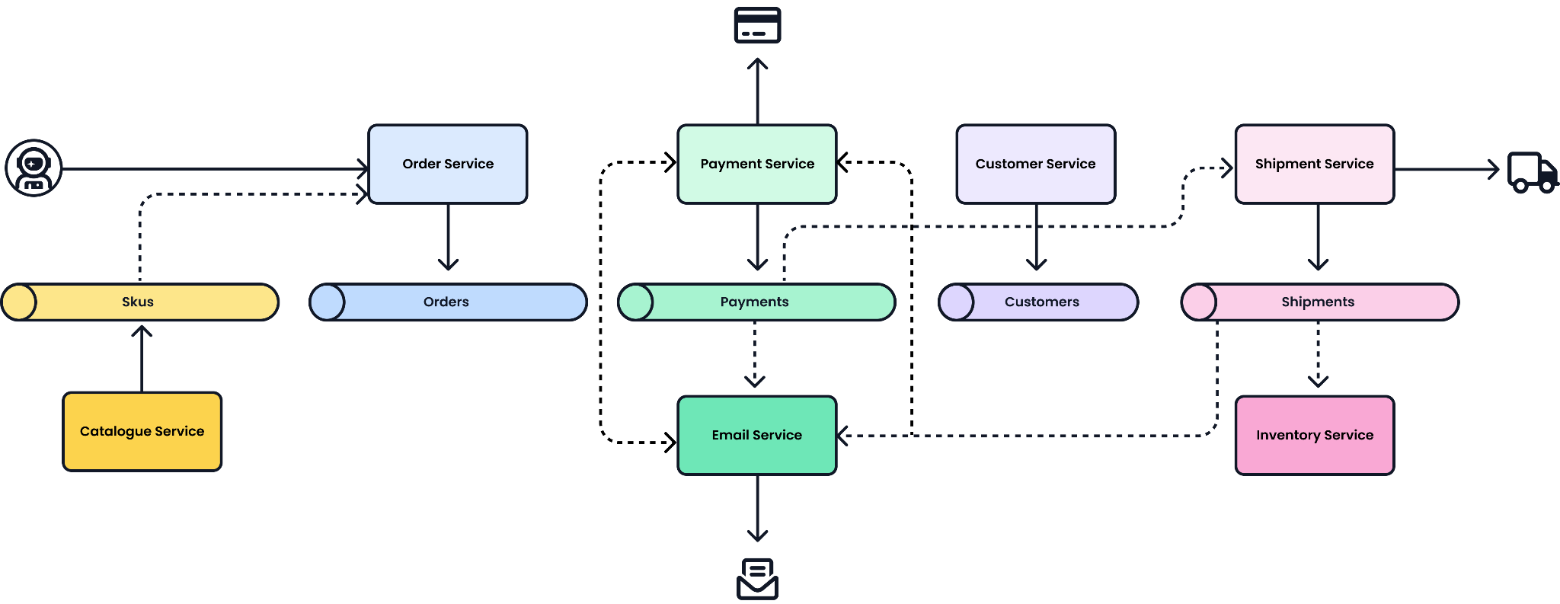
Modern systems architectures employ distributed systems
Promises efficiency, scale and ease

Slide 3
…but, what can go wrong, will.
A queue can backup or overflow
Our modern application architectures are powerful but challenging
How do you rollback state prior to the point of failure?
How do you retry the overall process flow without data corruption?
A process or service can fail
X
A database can go offline or fail
An API can fail or timeout

Slide 4
…and even when all is well, we still have challenges
Shared state across multiple services
How do you share state across services?
How do guarantee idempotent transactions across services?
How do you manage a process over long periods of time?
Cross service transaction
Long running process
Notes:
Contending with these issues - feature velocity

Slide 5
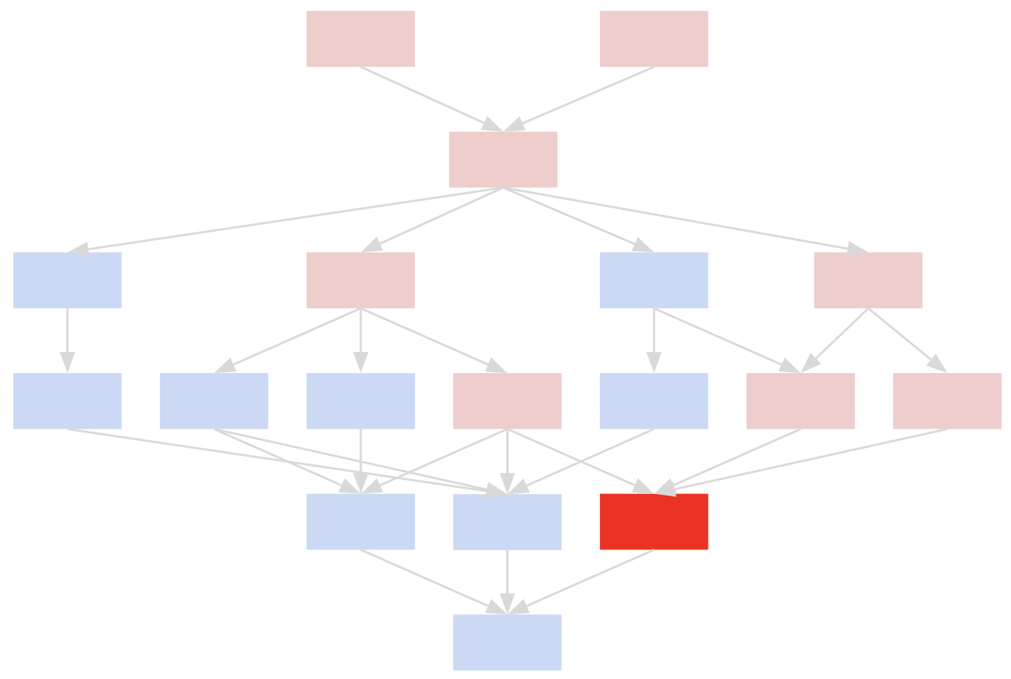
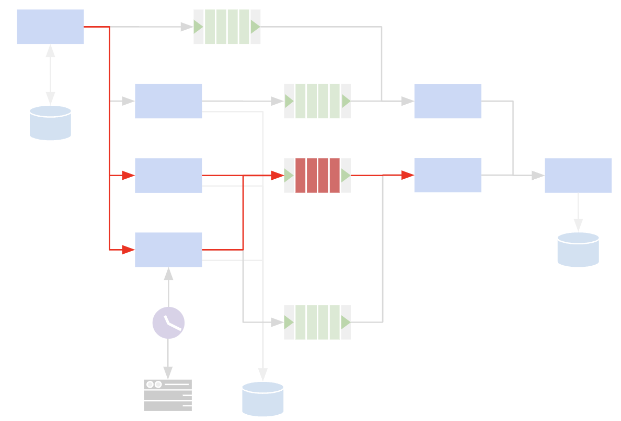
AND, as we grow, everything becomes more complex
increased COMPLEXITY
As you add features, you add services and complexity
Rollbacks?
Retries?
State management?
As you scale, you add dependencies and waits
Service reliability?
Queue issues?
Long running services?
decreased
VELOCITY & RELIABILITY
MATURITY & TIME
Notes:
Not success - modularity - domain expansion - functional sophistication - greed for more functionality

Slide 6
Ultimately, we have more efficient systems, but are less productive
A queue can backup or overflow
Shared state across multiple services
IMPACT
Developers become less productive and lose focus
Decreased feature velocity
Reliability of systems suffer
Difficult to get end-to-end insight across your process flows
A process or service can fail
Cross service transaction
X
Long running process
A database can go offline or fail
An API can fail or timeout

Slide 7
There has to be a better way!
A queue can backup or overflow
Shared state across multiple services
Development Patterns?
Saga Pattern, Batch Process, Circuit Breaker, CQRS, Deadletter
Development patterns solve only one part of the problem
Why not?
Polyglot applications
Multiple problems
Additional complexity
A process or service can fail
Cross service transaction
X
Long running process
A database can go offline or fail
An API can fail or timeout

Slide 8




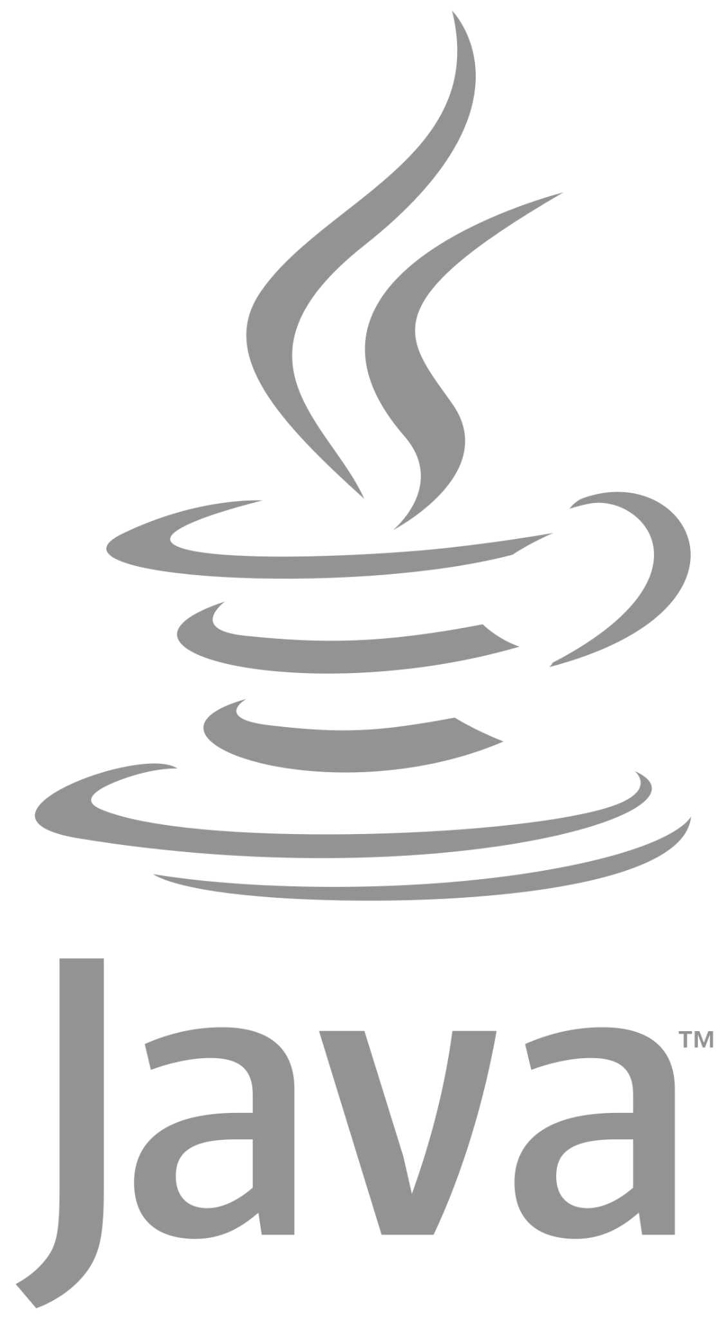

Temporal: a better way!
YOUR ENVIRONMENT, YOUR CODE
SDK
Temporal Worker Fleet
Temporal workers
Temporal Server
Temporal workers
Workflow Management
Event History & State
Query & Manage
SDK
SDK
SDK
Temporal abstracts away the complexities around retries, rollbacks, queues, state machines, and timers
Code in your language using a Temporal SDK

Slide 9
Temporal delivers Durable Execution
YOUR ENVIRONMENT, YOUR CODE
Establish policy for retries/restarts
Replay a workflow from anywhere
Ensure consistent state across services
Set timers and schedules
Simplify your code… in your language and across disparate services
SDK
Temporal Worker Fleet
Temporal workers
Temporal Server
Temporal workers
Workflow Management
Event History & State
Query & Manage
SDK
SDK
SDK
Code in your language using a Temporal SDK

Slide 10

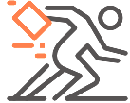

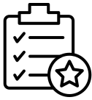
delivers Durable Execution
Temporal is an open source programming model that can simplify your code, make your applications more reliable, and help you deliver more features faster.
Speed Development
Reduces code complexity by offloading error processing logic to a central platform, allowing you to focus on what matters, business logic.
Elegantly fail
Guarantees that any end-to-end process, workflow or string of services will execute completely, retry, rollback and commit gracefully
Ensure Data Integrity
Maintains state across your services and ensure all your data is free of inconsistencies or irregularities even across disconnected services
Speed Operations
Every execution is recorded to allow for recoverability, replayability and correctness

Slide 11
How is Temporal used?
Transactions
Money movement
Order management/fulfillment
State synchronization
A Temporal Workflow can be any process or series of events you want to guarantee correct and reliable.
Processes
Customer Experience
Supply Chain
Documented process
Lifecycles
Inventory management,
Menu/listing versioning
User management
Operations
Infrastructure services
CI/CD workflows
Data & ML pipelines

Slide 12
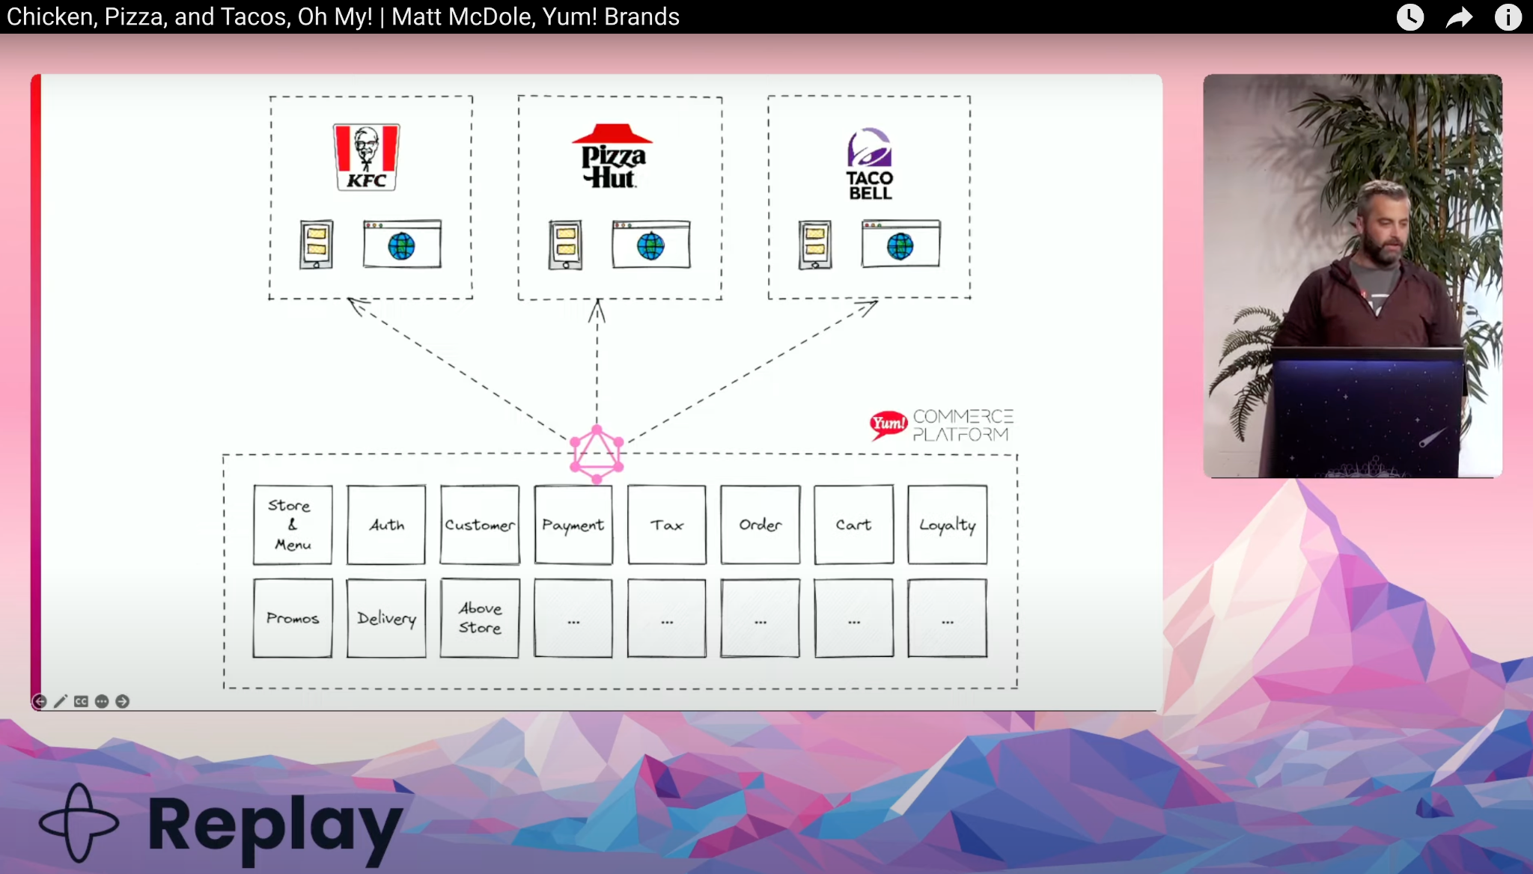
Temporal at Yum Brands

Slide 13
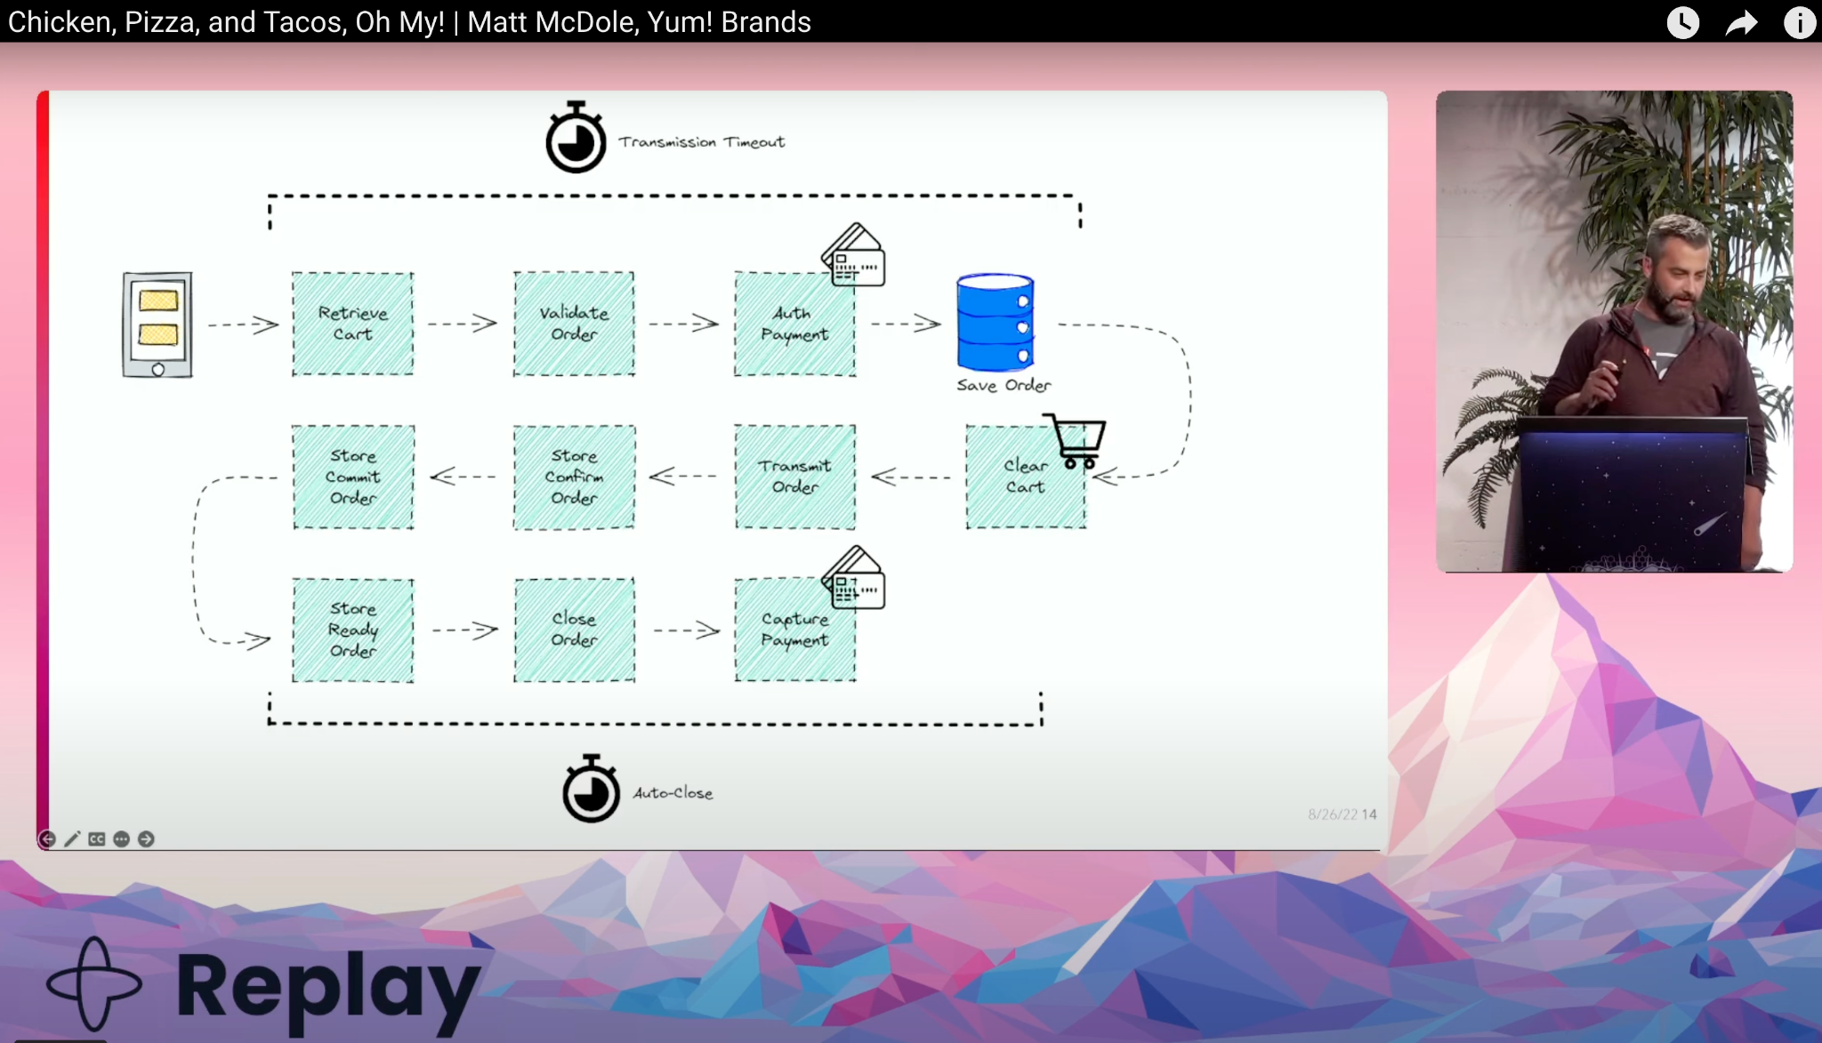
Life of a food order

Slide 14
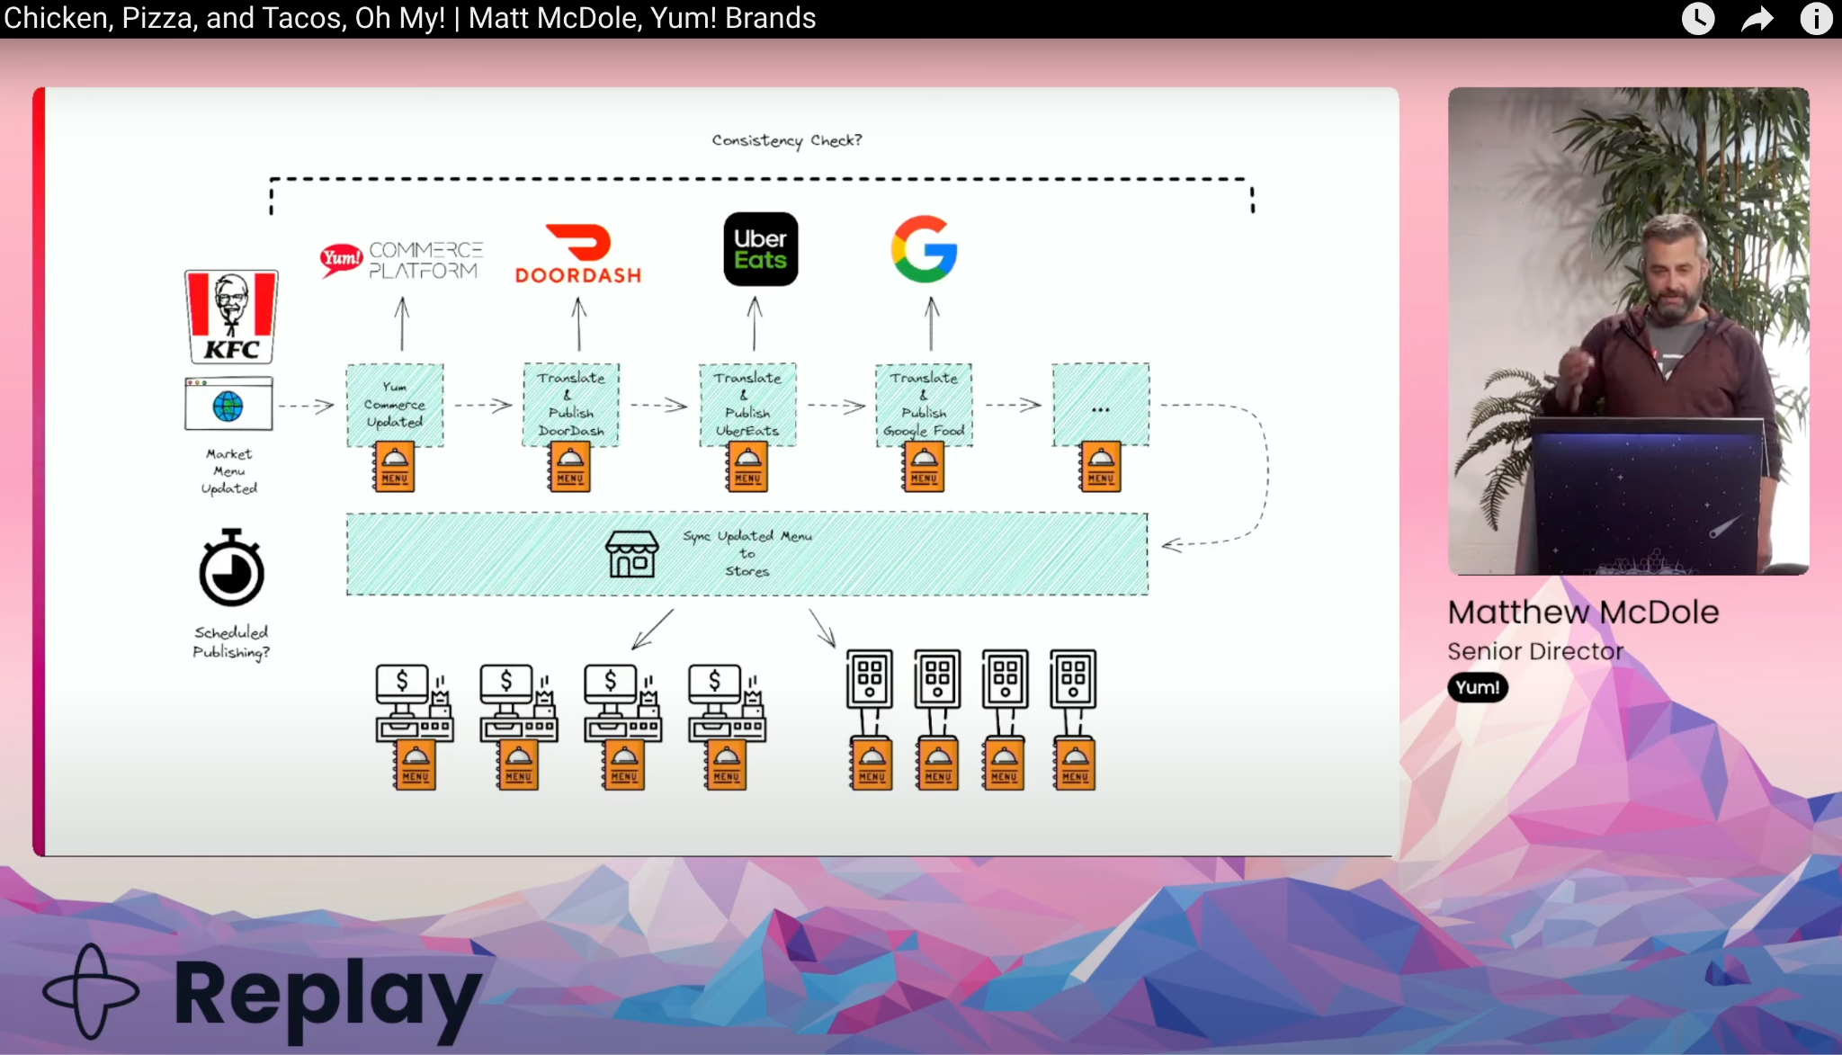
Store & Menu management

Slide 15
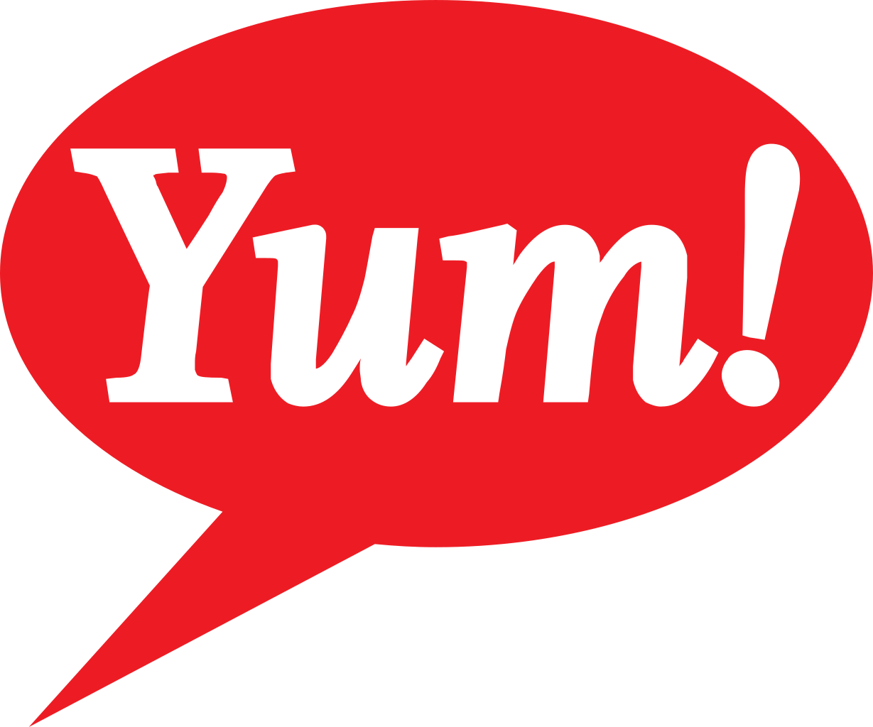



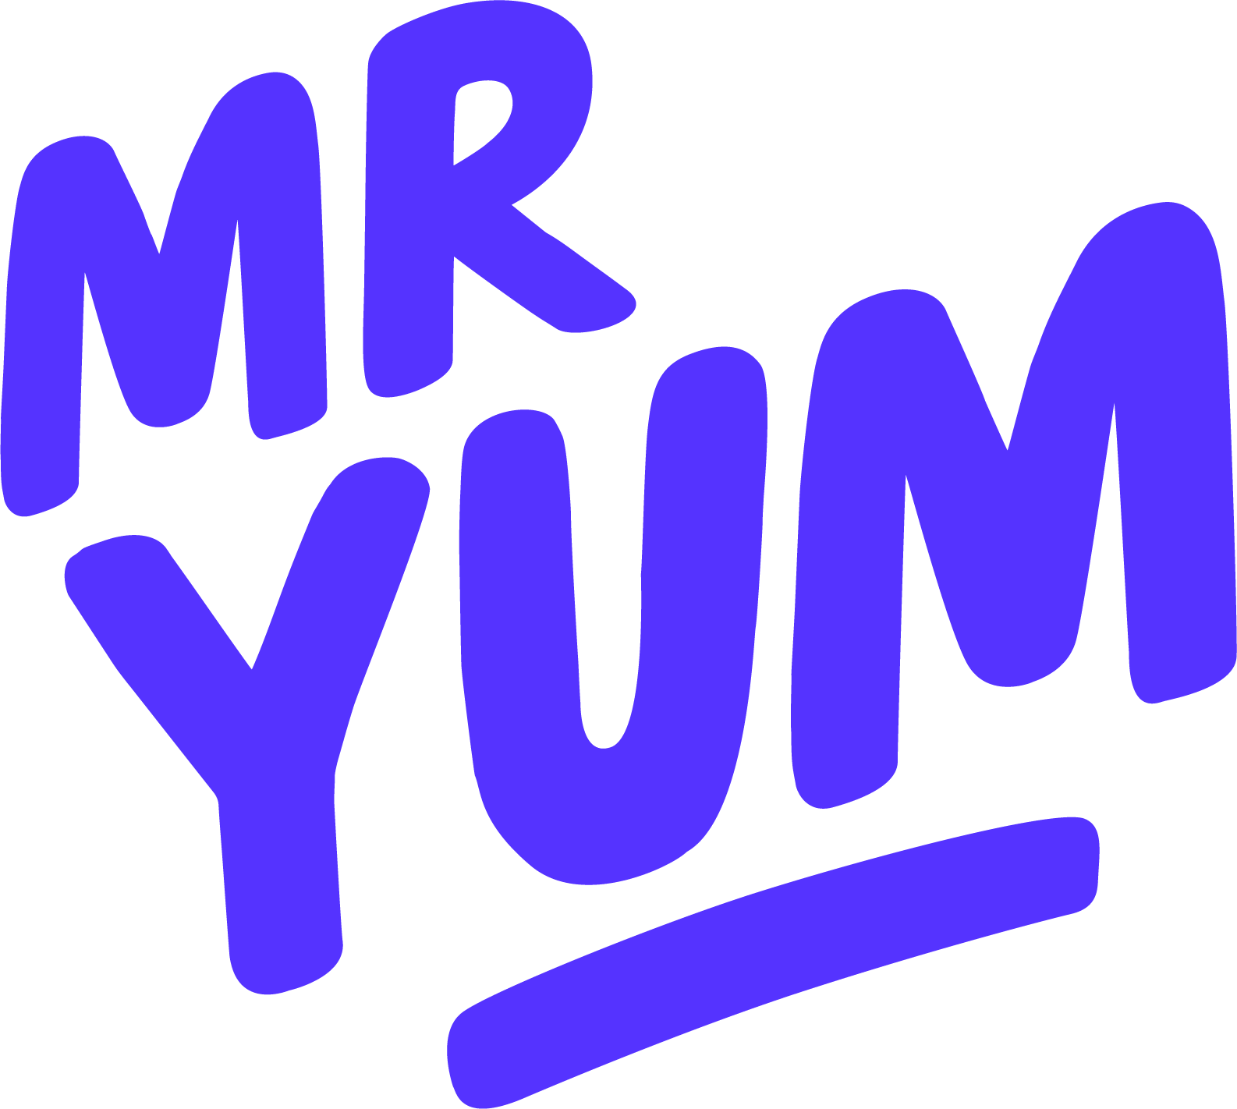











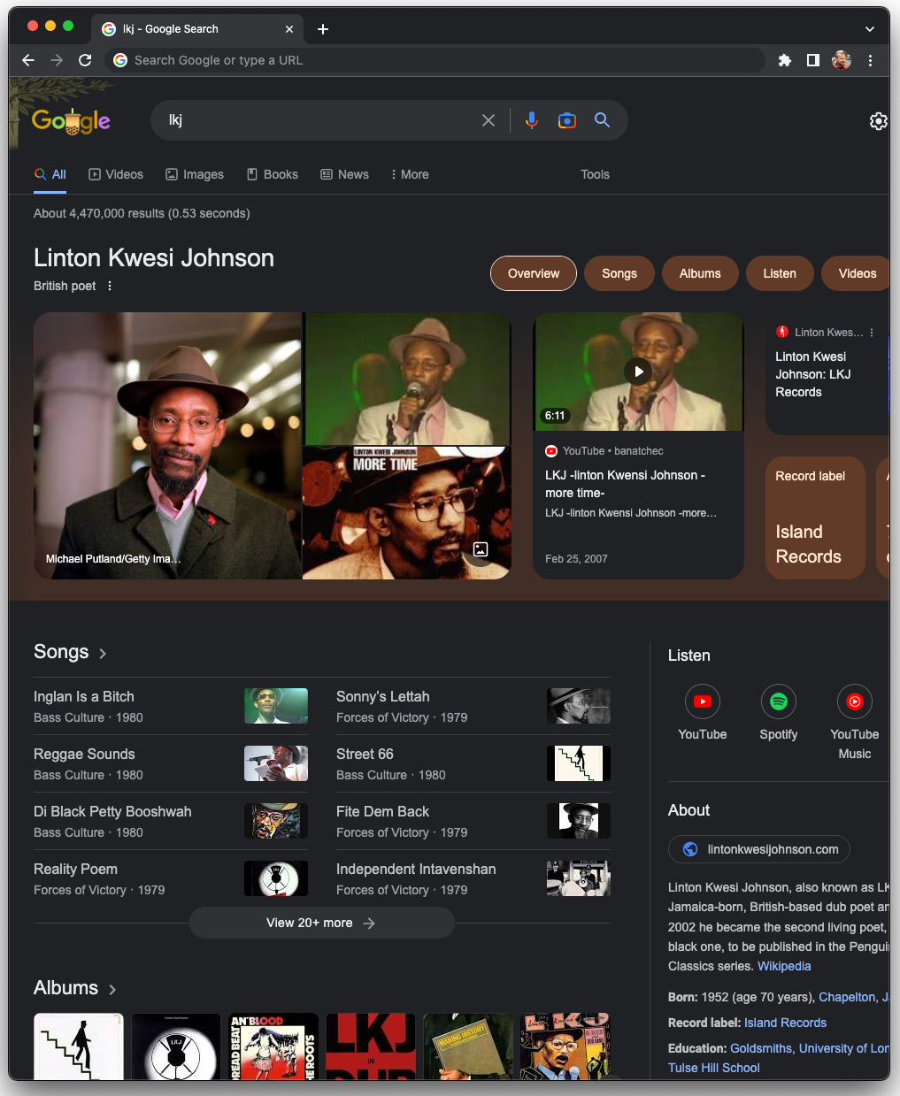


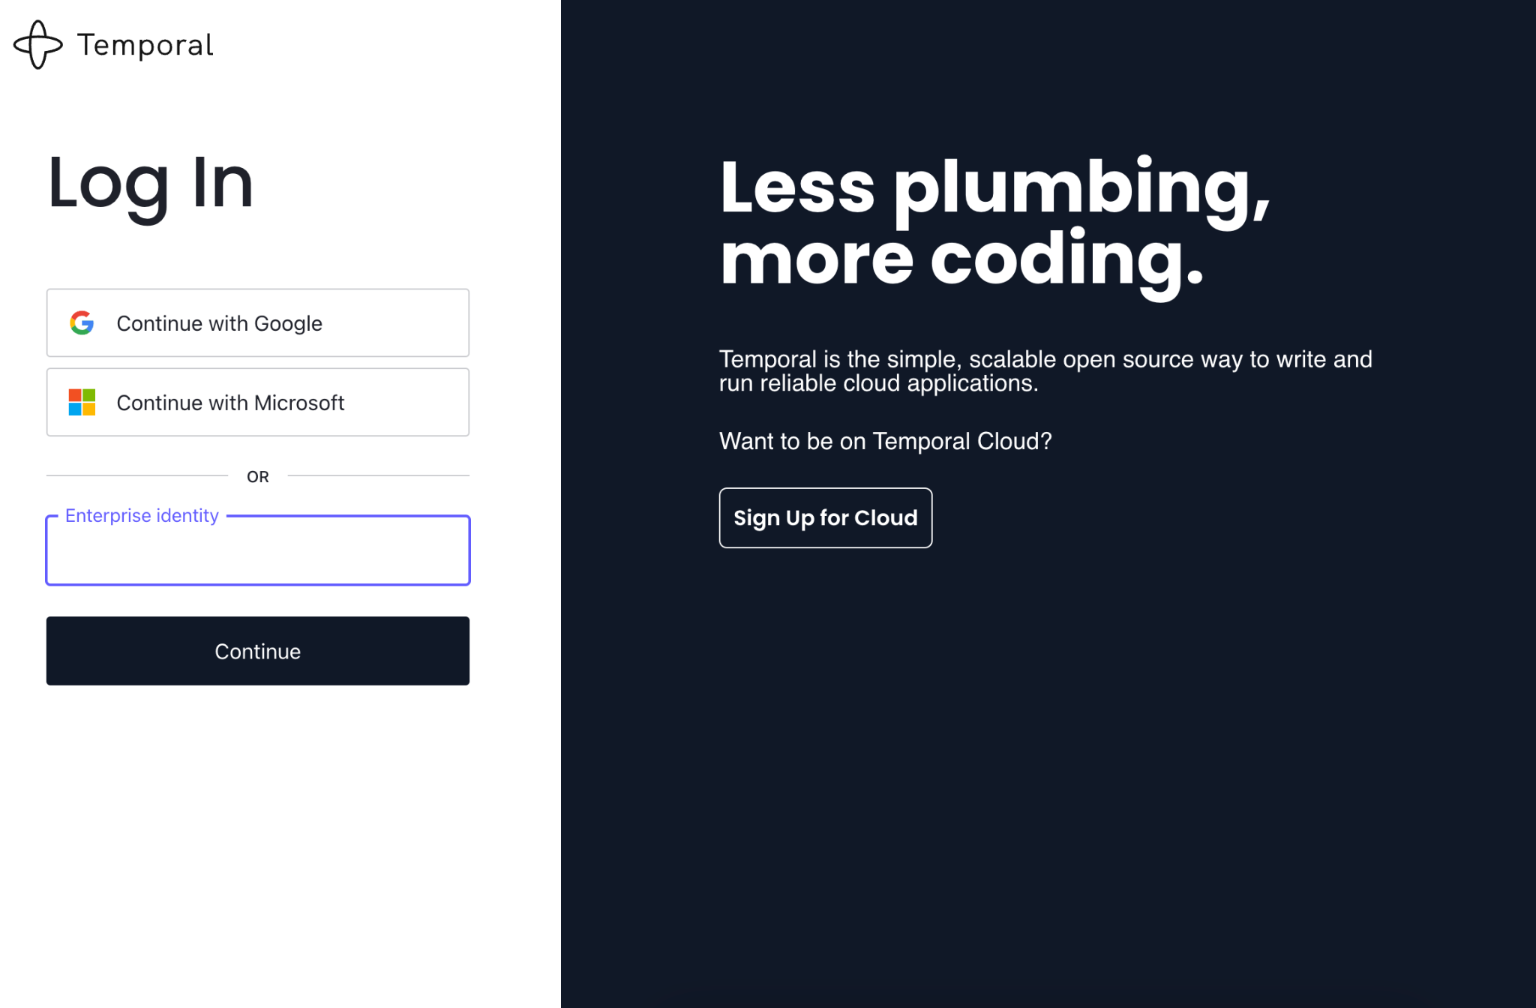

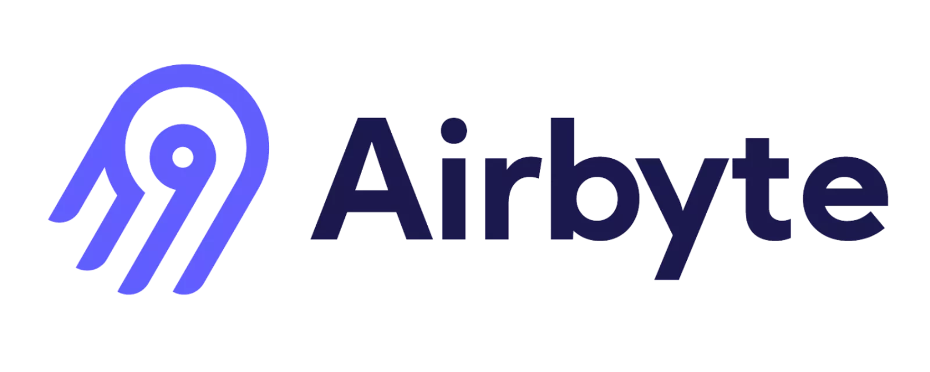







Slide 16
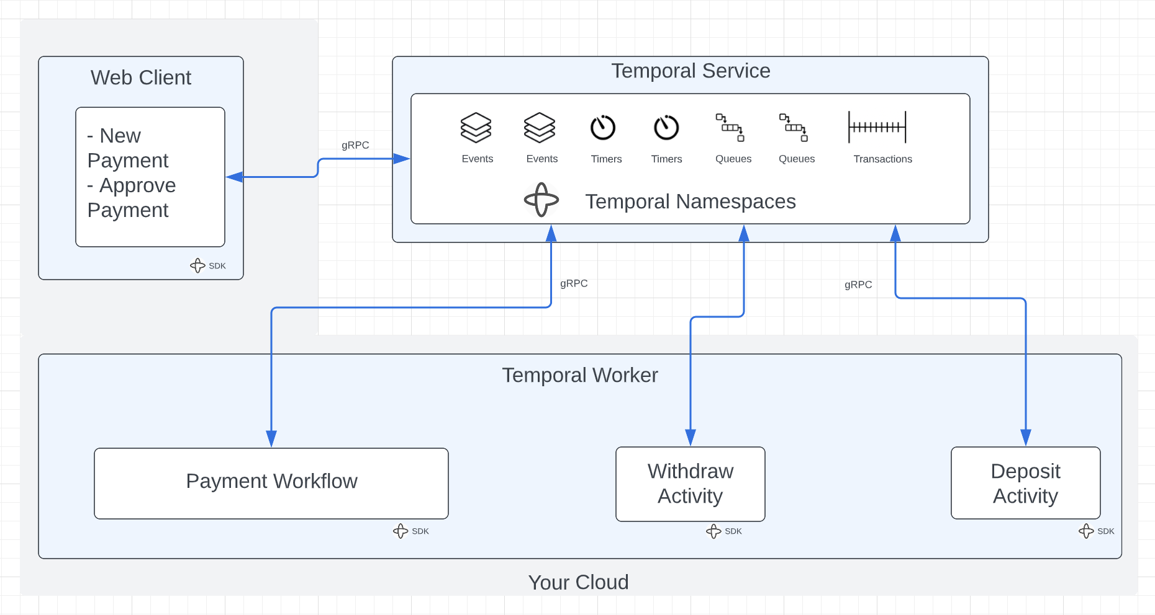
Demo !

Slide 17
Questions

